Slide 1
Name : NAGAR DISHA P. ENROLLMENT NO :2204030102077 PROJECT GUIDE : JAINEEL NAGAR SEMESTER : 2 CLASS : M1A4 SUBJECT NAME : INTERNSHIP OGT COLLEGE : SILVER OAK COLLEGE OF COMPUTER APPLICATION

Slide 2
PROJECT - DISHA NAME STATIONERY

Slide 3
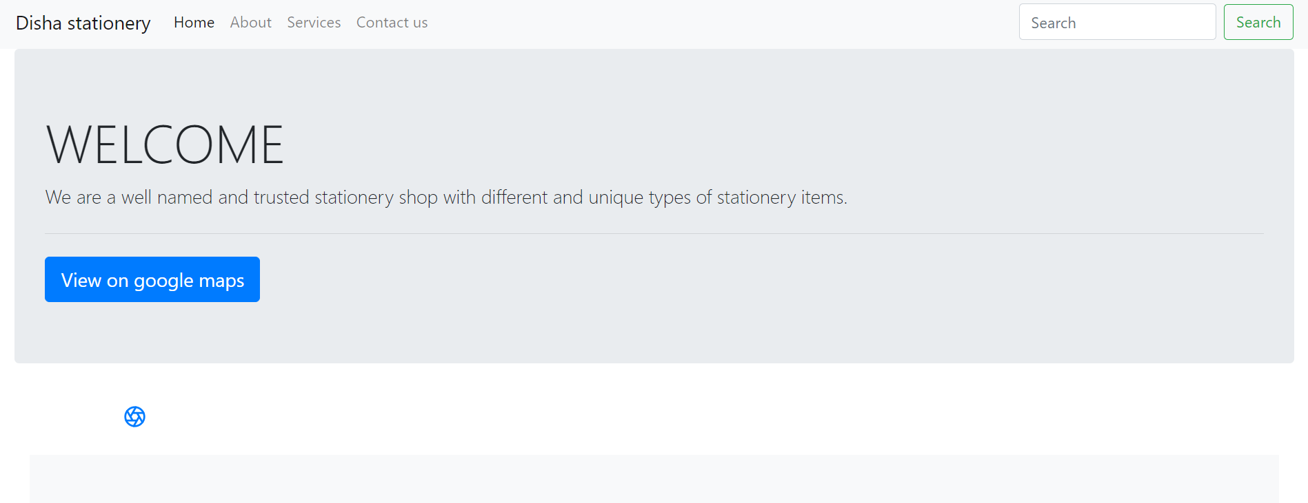
HOME PAGE

Slide 4
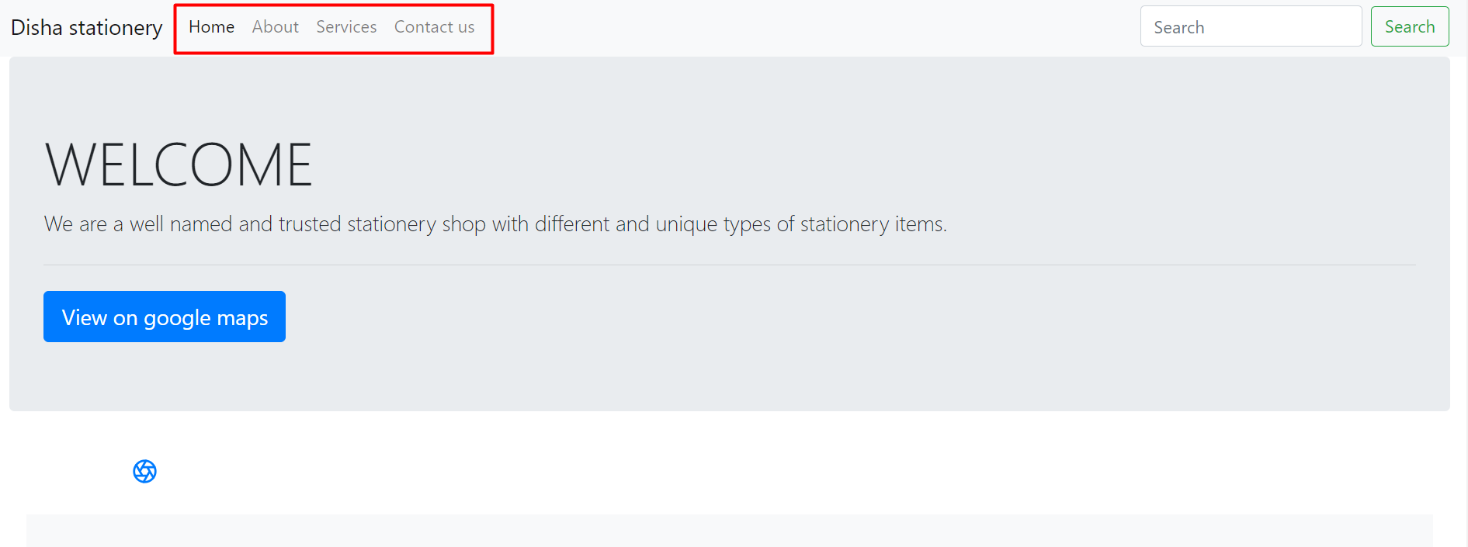
HEADER

Slide 5
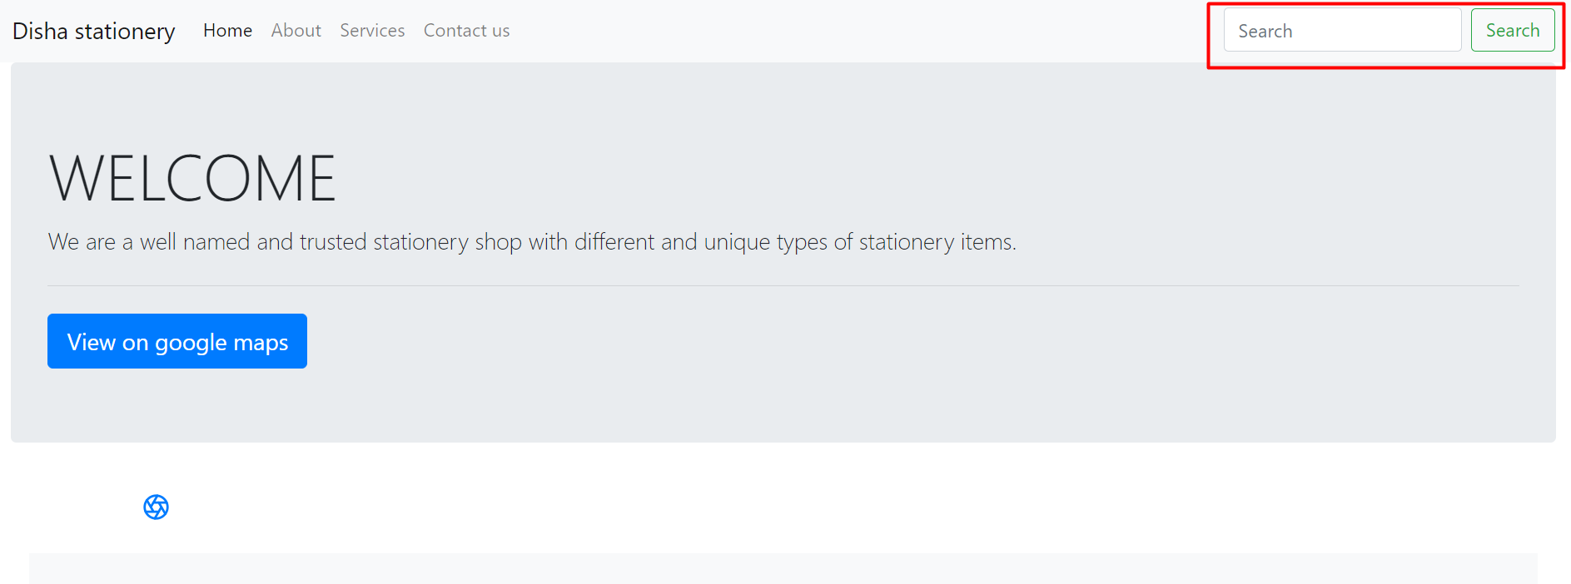
SEARCH BAR

Slide 6

ALL NECESSARY ITEMS ARE THERE

Slide 7
PROJECT ITEMS

Slide 8

WRITTING ITEMS

Slide 9

BOOKS ITEMS

Slide 10

CRAFT MATERIALS

Slide 11
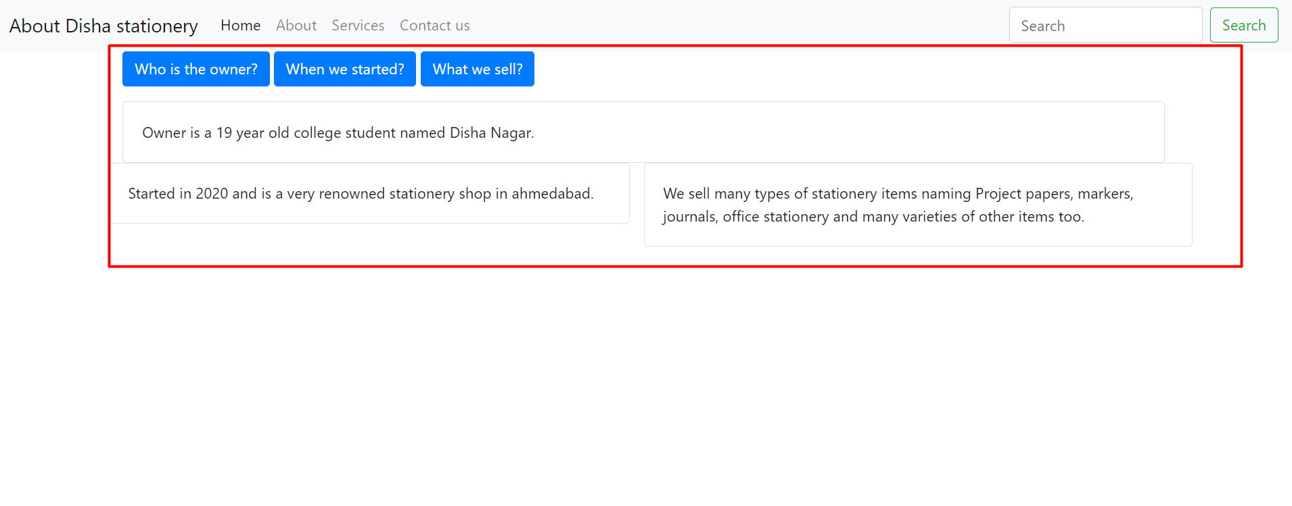
INFORMATION PAGE

Slide 12
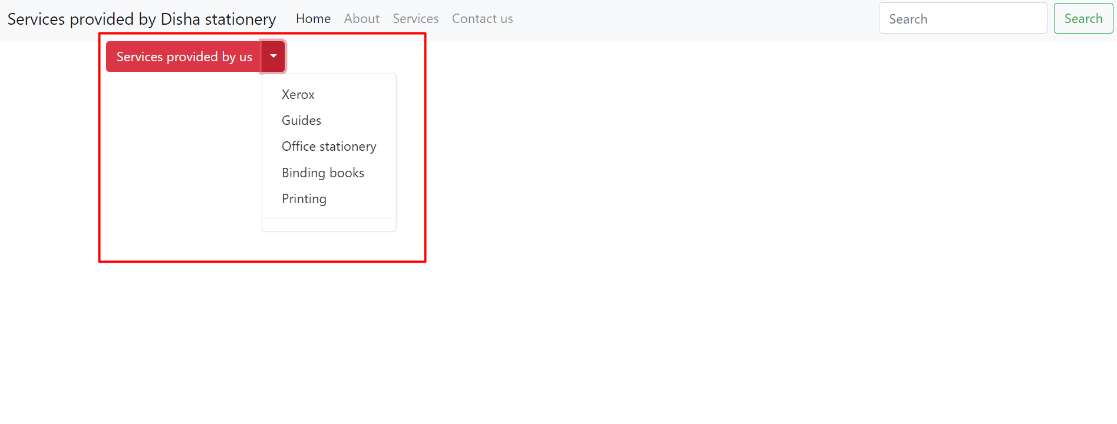
SERVICES BY US

Slide 13
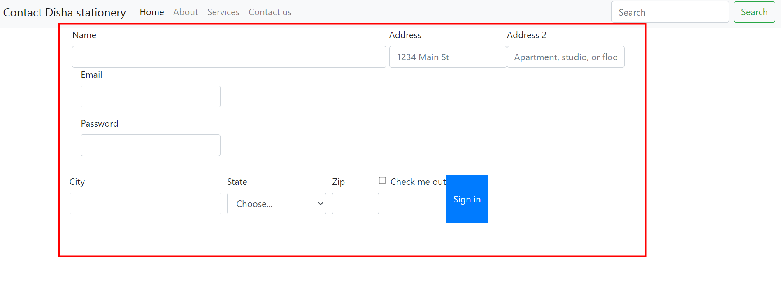
INDEX PAGE

Slide 14

FOOTER

Slide 15
THANK YOU…!!

